Slide 1
Two routes to a simple input
Can one or two sine waves do what the earthquake record does to the wall?
Yopi P. Oktiovan · Hanze University of Applied Sciences, Groningen
Progress meeting — US-1 wall model (3DEC), September 2026
Notes:
Today: the two routes we agreed on, what they give on an undamaged wall, and what they give on a wall that already has damage from the test sequence.

Slide 2
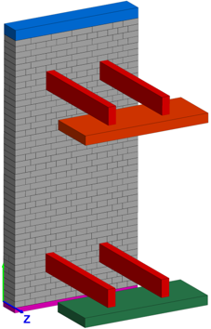
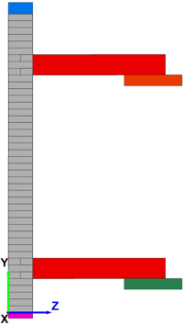
1
The question
One test wall, one record, two ways to replace the record
The goal
The test case
The two routes
Replace the 17 s earthquake record by one or two sine waves that give the model the same wall movement.
Cheaper, and the wave can be tuned to the state of the wall.
SAFEGo wall US-1, run 24 (FR76 × 1.75).
Measured: 29.5 mm out-of-plane at 2.06 m, 29.5 kN base shear.
Model: 3DEC, rigid blocks, all damage in the joints.
Route 1 (Eleni): one sine wave with the record’s peak velocity.
Route 2 (Ihsan): two sine waves, one at the first period of the wall, one at the softened period.
How we judge a route
First against the record on the same model: does the wave move the model as much as the record does?
Then against the test: 29.5 mm and 29.5 kN at run 24.
Two checks, in that order. A route can pass the first and still not the second.
Notes:
Keep the two checks apart. The first is about the wave. The second is about the model.

Slide 3
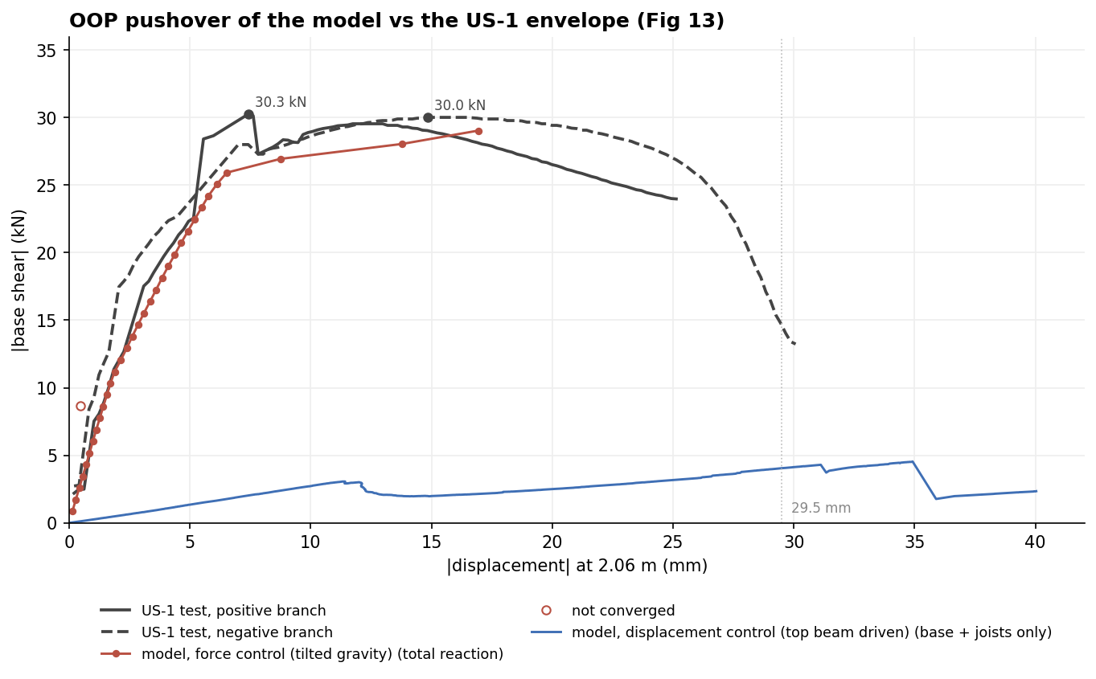
2
Before the routes: pushing the model over, two ways
The static force-displacement curve of the model, needed for Route 2 and for the check against the test
Force control (tilted gravity)
Load grows step by step until the model cannot hold it.
Follows the test curve up to the peak: 29.0 kN at 17 mm; test 29.5 kN. Rocking starts at 7–8 mm.
Stops at the peak: no equilibrium on the falling branch.
Displacement control (pushing the top beam)
Top beam moved at a fixed speed, base shear read.
Only 3–5 kN at 30 mm. Pushing the restrained top beam measures sideways sliding, not rocking. Not a capacity curve.
Model curves against the test envelope (Fig 13). Force control: total reaction; displacement control: base + joists only. Hollow point = step that did not converge.
Force control: right peak, no falling branch. Top-beam displacement control: wrong curve. New driver (ready): hold the wall at a target displacement with the same tilted-gravity load.
Notes:
The descending branch matters for the secant period at large displacement. The new driver keeps the load pattern of the force-controlled push and controls displacement by feedback; results to come.

Slide 4
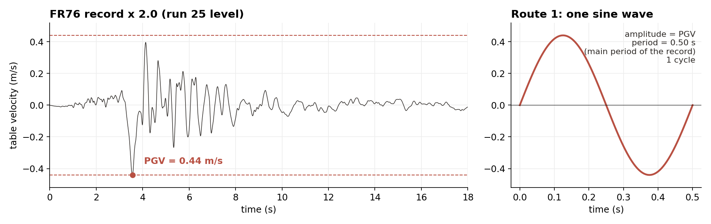
3
Route 1: one sine wave with the record’s peak velocity
Eleni’s route — nothing about the wall goes in
Amplitude: the peak velocity of the record, times the run’s scale factor (0.44 m/s at run-25 level).
Period: the main period of the record (0.50 s). One cycle.
Simple and fixed. If it works, no wall information is needed.
Notes:
One cycle. More cycles would give every cycle the peak velocity, which the record does not do.

Slide 5
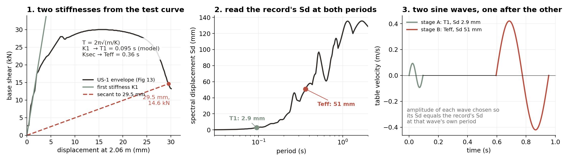
4
Route 2: two sine waves, one after the other
Ihsan’s route — the wave follows the state of the wall
Stage A: period = first period of the model (0.095 s). Amplitude set so its Sd equals the record’s Sd there (2.9 mm at run-25 level).
Stage B: period from the secant to 29.5 mm on the test curve, using the envelope force (14.6 kN) and m = 1635 kg: T = 0.36 s. Amplitude set so its Sd equals the record’s Sd there (51 mm).
Both stages one cycle, 0.5 s of quiet between them.
Notes:
Stage A represents the start, near elastic. Stage B puts the demand at the period the softened wall should have. Envelope force for the secant, as agreed.

Slide 6
5
Three tests
Same model, same input level, three starting points
Test 1: undamaged wall
Reference: the record
Test 2: damaged wall
Start from the new wall.
Apply Route 1 or Route 2 at run-25 level (FR76 × 2.0).
One shot. The wall has no damage when the wave arrives.
Drive the model with the real table motion, all 25 runs in the test order (Strategy F).
This is what a route has to reproduce: the record’s effect on this model.
Restart from the model state at the end of run 23 or run 24 of the record sequence.
Apply Route 2 at the next run’s level.
Compare with what the record did in that next run.
Test 1 asks: can the waves crack the wall? Test 2 asks: once the wall is cracked, do the waves move it as much as the record does?
Notes:
The restart test removes the damage history from the question. Same state, same level, wave instead of record.

Slide 7
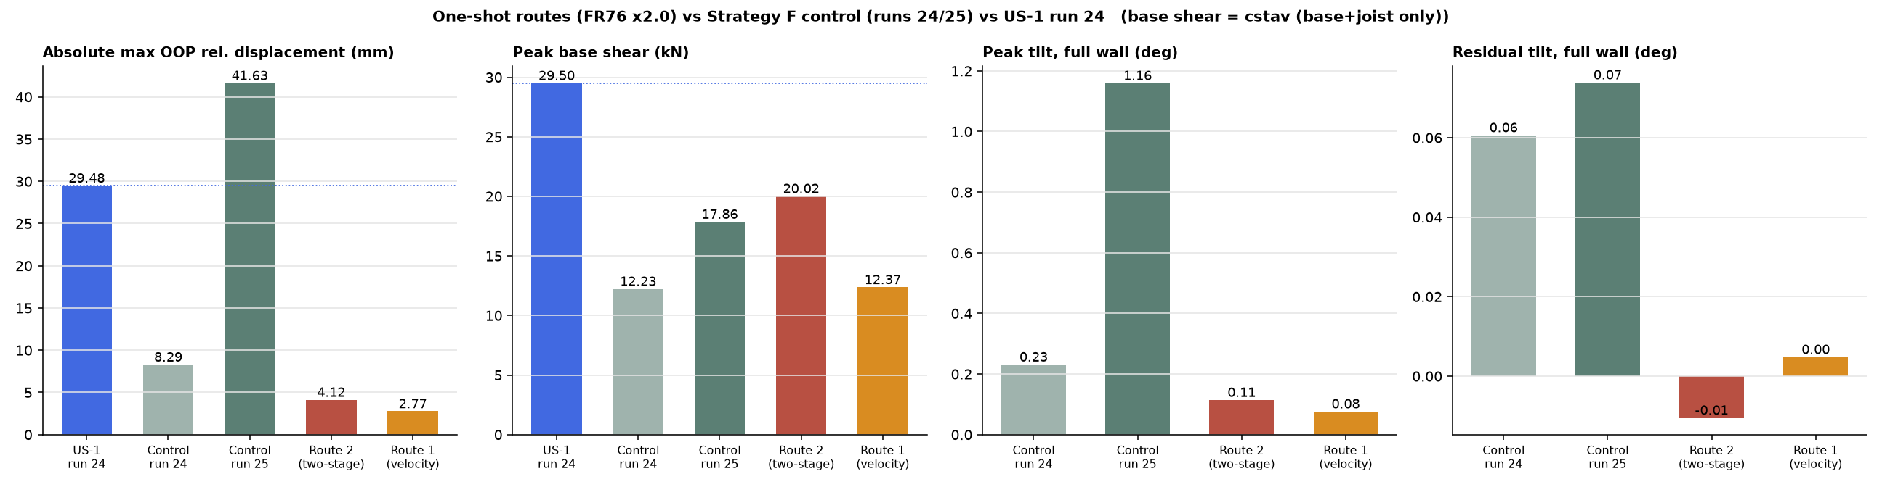
6
Test 1 result: on the undamaged wall both routes do very little
Peak values of the one-shot runs, next to the record on the same model and the test
Numbers
Reading
Route 1: 2.8 mm. Route 2: 4.1 mm.
Record on the model: 8.3 mm at ×1.75, 41.6 mm at ×2.0.
Test US-1 at run 24: 29.5 mm.
Neither wave cracks the new wall. The record at ×2.0 does, and then the model moves a lot.
Base shear is base + joists only in the model (no top-joint share yet), so the force bars are not like-for-like with the test.
Notes:
Route 1 at 0.56 g single cycle and Route 2 stage A at 2.9 mm elastic demand both stay below the cracking level of the new wall.

Slide 8
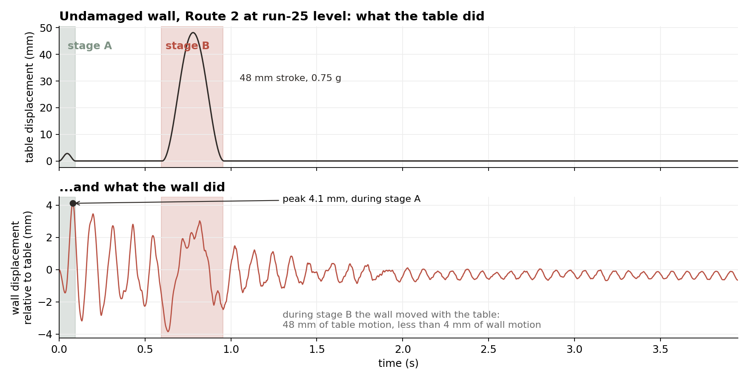
7
Why: stage B needs a wall that is already soft
Route 2 on the undamaged wall, run-25 level
What happened
Stage A (2.9 mm demand at 0.095 s): the wall answers with 4.1 mm. That is the peak.
Stage B is a 48 mm, 0.75 g push at 0.36 s. The wall was still at ~0.1 s, so it just rode along with the table.
The 51 mm of Sd at 0.36 s only exists for a wall that is already at 0.36 s.
Stage B is built for a soft wall. On a stiff wall it does nothing. So the next test starts from a wall the record has already cracked.
Notes:
Chicken and egg: the wall must be soft to feel stage B, and stage B is what was meant to make it soft.

Slide 9
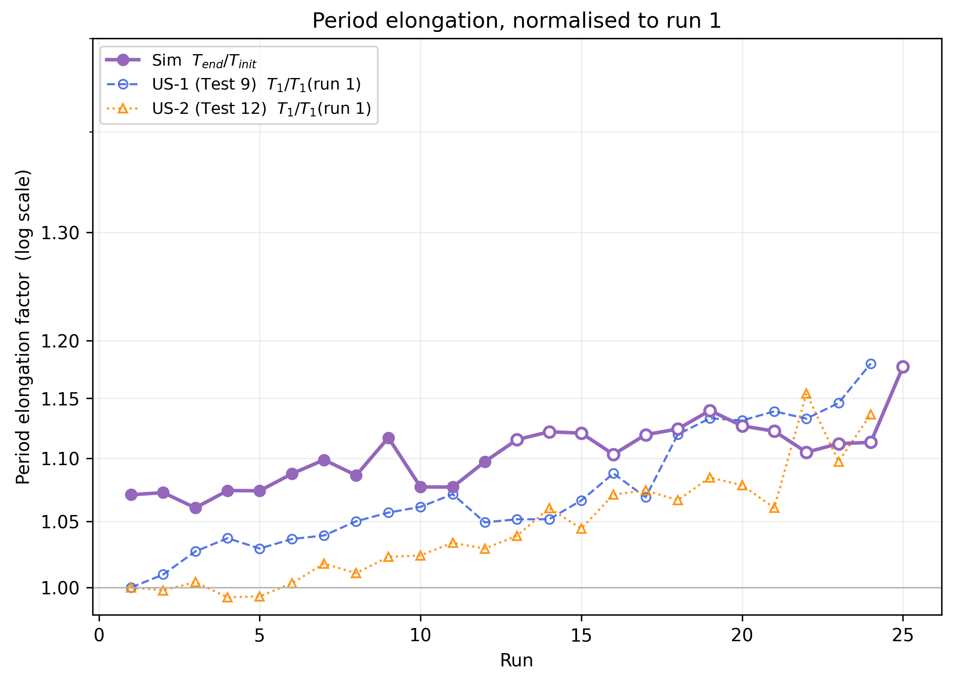
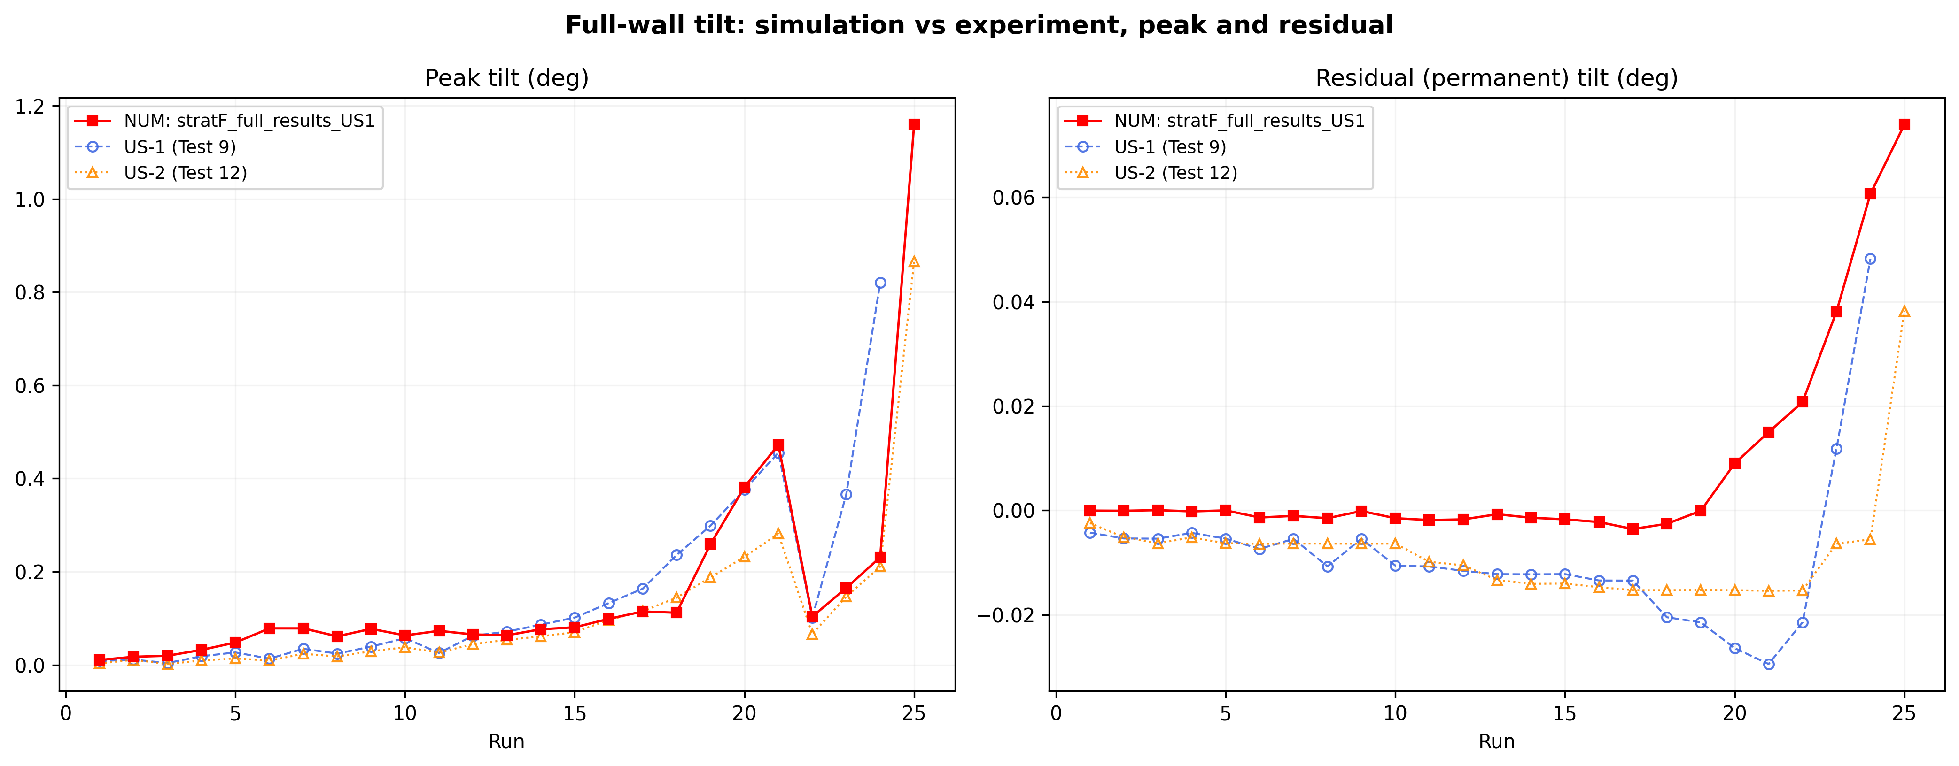
8
Reference: period and tilt tell the same story
Model vs both test walls, run by run
Period
Tilt
The model’s period grows about 4% from run 1 to run 24 and 10% by run 25. The test wall grew 17.5% by run 24.
The model softens one step later than the test.
Peak tilt follows the test up to run 21 and then lags, like the displacement.
The permanent tilt of the model leans the other way than US-1 over runs 15–22 — to be checked (sign convention or joist side).
Notes:
Period plot normalised to run 1 for both. The tilt sign difference is a loose end, not the main point.

Slide 10
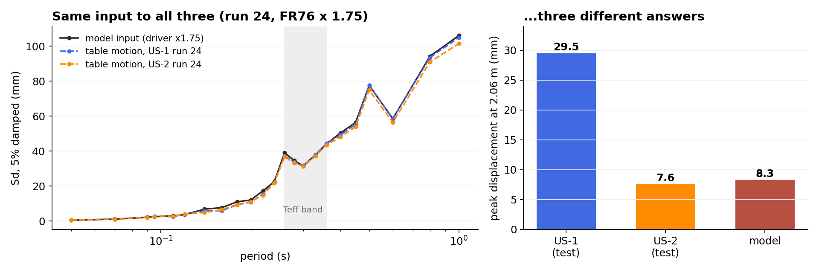
9
Same input, two test walls, two answers
Run 24 on US-1 and on US-2 (its twin), and on the model
Reading
The table gave both walls the same motion (spectra within 2–5%), and the model got the same input. US-1 moved 29.5 mm, US-2 moved 7.6 mm, the model 8.3 mm. The 29.5 mm target belongs to one of two twin walls; the paper itself reports a large unexplained difference between them.
Notes:
This changes what "validated" means. The model sits on US-2 at run 24. There is no measured property that separates US-1 from US-2 to tune towards.

Slide 11
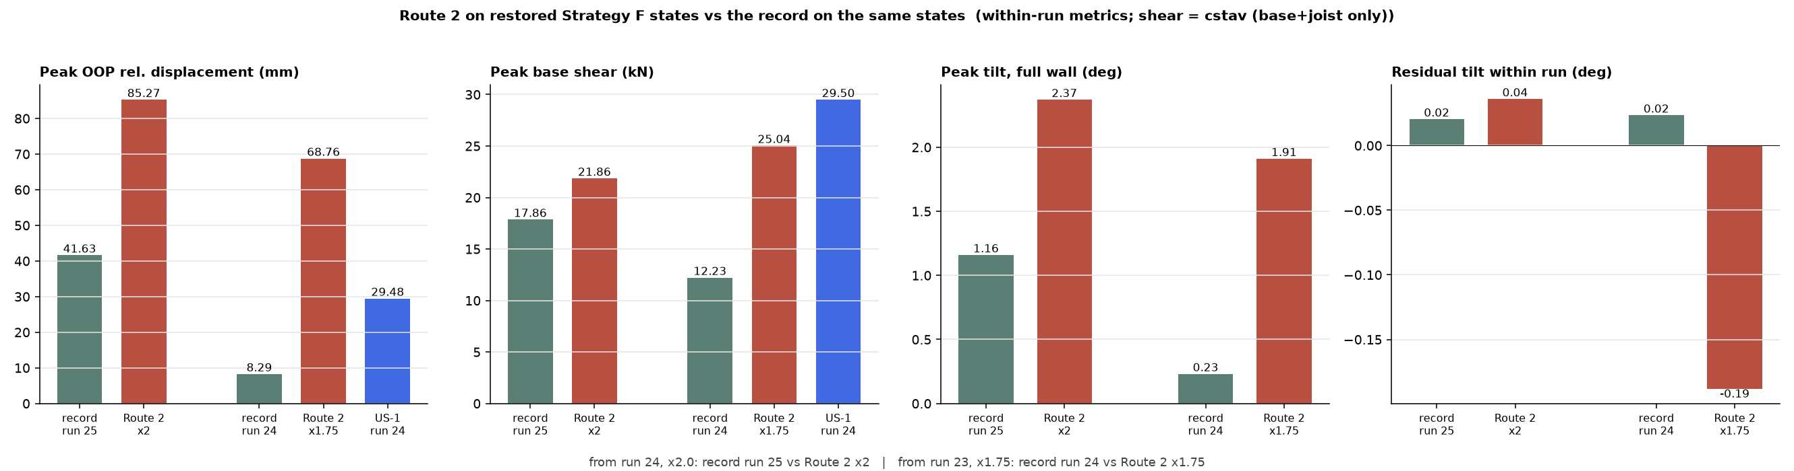
10
Test 2 result: on the damaged wall Route 2 does far too much
Restart from the record state, apply Route 2, compare with the record on the same state
Numbers
Reading
From run 24 at ×2.0: Route 2 gives 85 mm, the record gives 42 mm (2×).
From run 23 at ×1.75: Route 2 gives 69 mm, the record gives 8 mm (8×).
One big sine cycle at 0.36 s is a 48 mm push in 0.18 s. A cracked, rocking wall follows that push almost fully.
The record has the same Sd at 0.36 s, but its pushes are shorter and go both ways, so the wall ends up at half of that.
Notes:
Matching the spectral displacement at one period does not control how strong the single push is. That is what the rocking wall responds to.

Slide 12
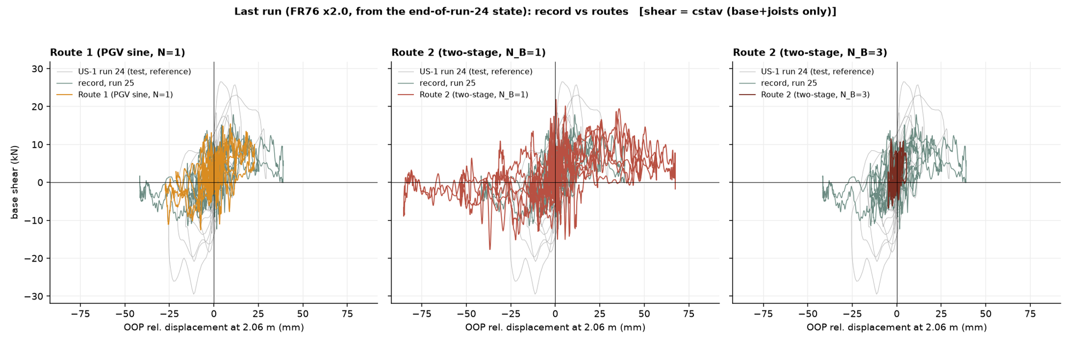
11
Same damaged wall, same level: the record vs three waves
Base shear vs displacement, last run (FR76 x2.0) from the end-of-run-24 state
The record (run 25) takes the wall to 42 mm.
Route 1, one wave with the record’s peak velocity: about 25 mm. Closest of the three; same loop shape and force level as the record.
Route 2 with one cycle: 85 mm, twice the record. With three cycles: 8 mm, a fifth of it. Same Sd target, opposite answers.
All three reach a similar base shear (10–20 kN). They differ in how far the wall rocks, not in how hard it pushes back.
The wave that carries the record’s velocity gets closest. The waves that carry its Sd at one period miss in both directions.
Base shear = base + joists only (about 55% of the total). Grey loop: US-1 run 24, reference only — run 25 was not applied to US-1.
Notes:
Route 1 is still 40% short, so it is not the answer either; but it points the way for the amplitude rule: velocity and pulse shape, not Sd. Strategy R is built on that.

Slide 13
12
What we learned
The two routes bracket the record, from both sides
Undamaged wall
Damaged wall
The model itself
Both routes: 3–4 mm.
Record: 8 to 42 mm.
Too little. The waves do not crack the wall.
Record: 42 mm.
Route 1: 25 mm. Route 2: 85 mm (1 cycle) or 8 mm (3 cycles).
The velocity wave comes closest; the Sd waves miss both ways.
Follows the test to 17 mm, sits on the twin wall US-2 at run 24, cracks one scale step after US-1.
Input to the model checked against the real table motion: fine.
Matching Sd at one period fixes the size of the wave but not how hard a single cycle pushes. A rocking wall answers the push, not the Sd.
Notes:
The descriptor is the problem, not the numbers in it. Both the under- and over-shoot come from using one cycle.

Slide 14
13
Next steps
Cheap tests first, then the decisions
1. Spread stage B over 3 cycles
2. Route 1 on the damaged wall
Same Sd target at 0.36 s, three smaller cycles instead of one big one (0.27 g instead of 0.75 g). Run from the same two saved states. Script ready.
Same restart test for the one-wave route, from run 23 and run 24. Script ready.
3. Full model force–displacement curve
4. Decisions for this meeting
Pushover with the falling branch (new driver). Needed for the secant period from the model instead of the test curve, and to compare with the test envelope.
Which wall is the target: US-1, US-2, or the range between them?
Confirmed so far: envelope force for the secant, model first period for stage A.
Notes:
Ask for the decision on the target wall. Everything else is runs I can do this week.

